Slide 1


Final Presentation
CLECKSHOPHUB

Slide 2
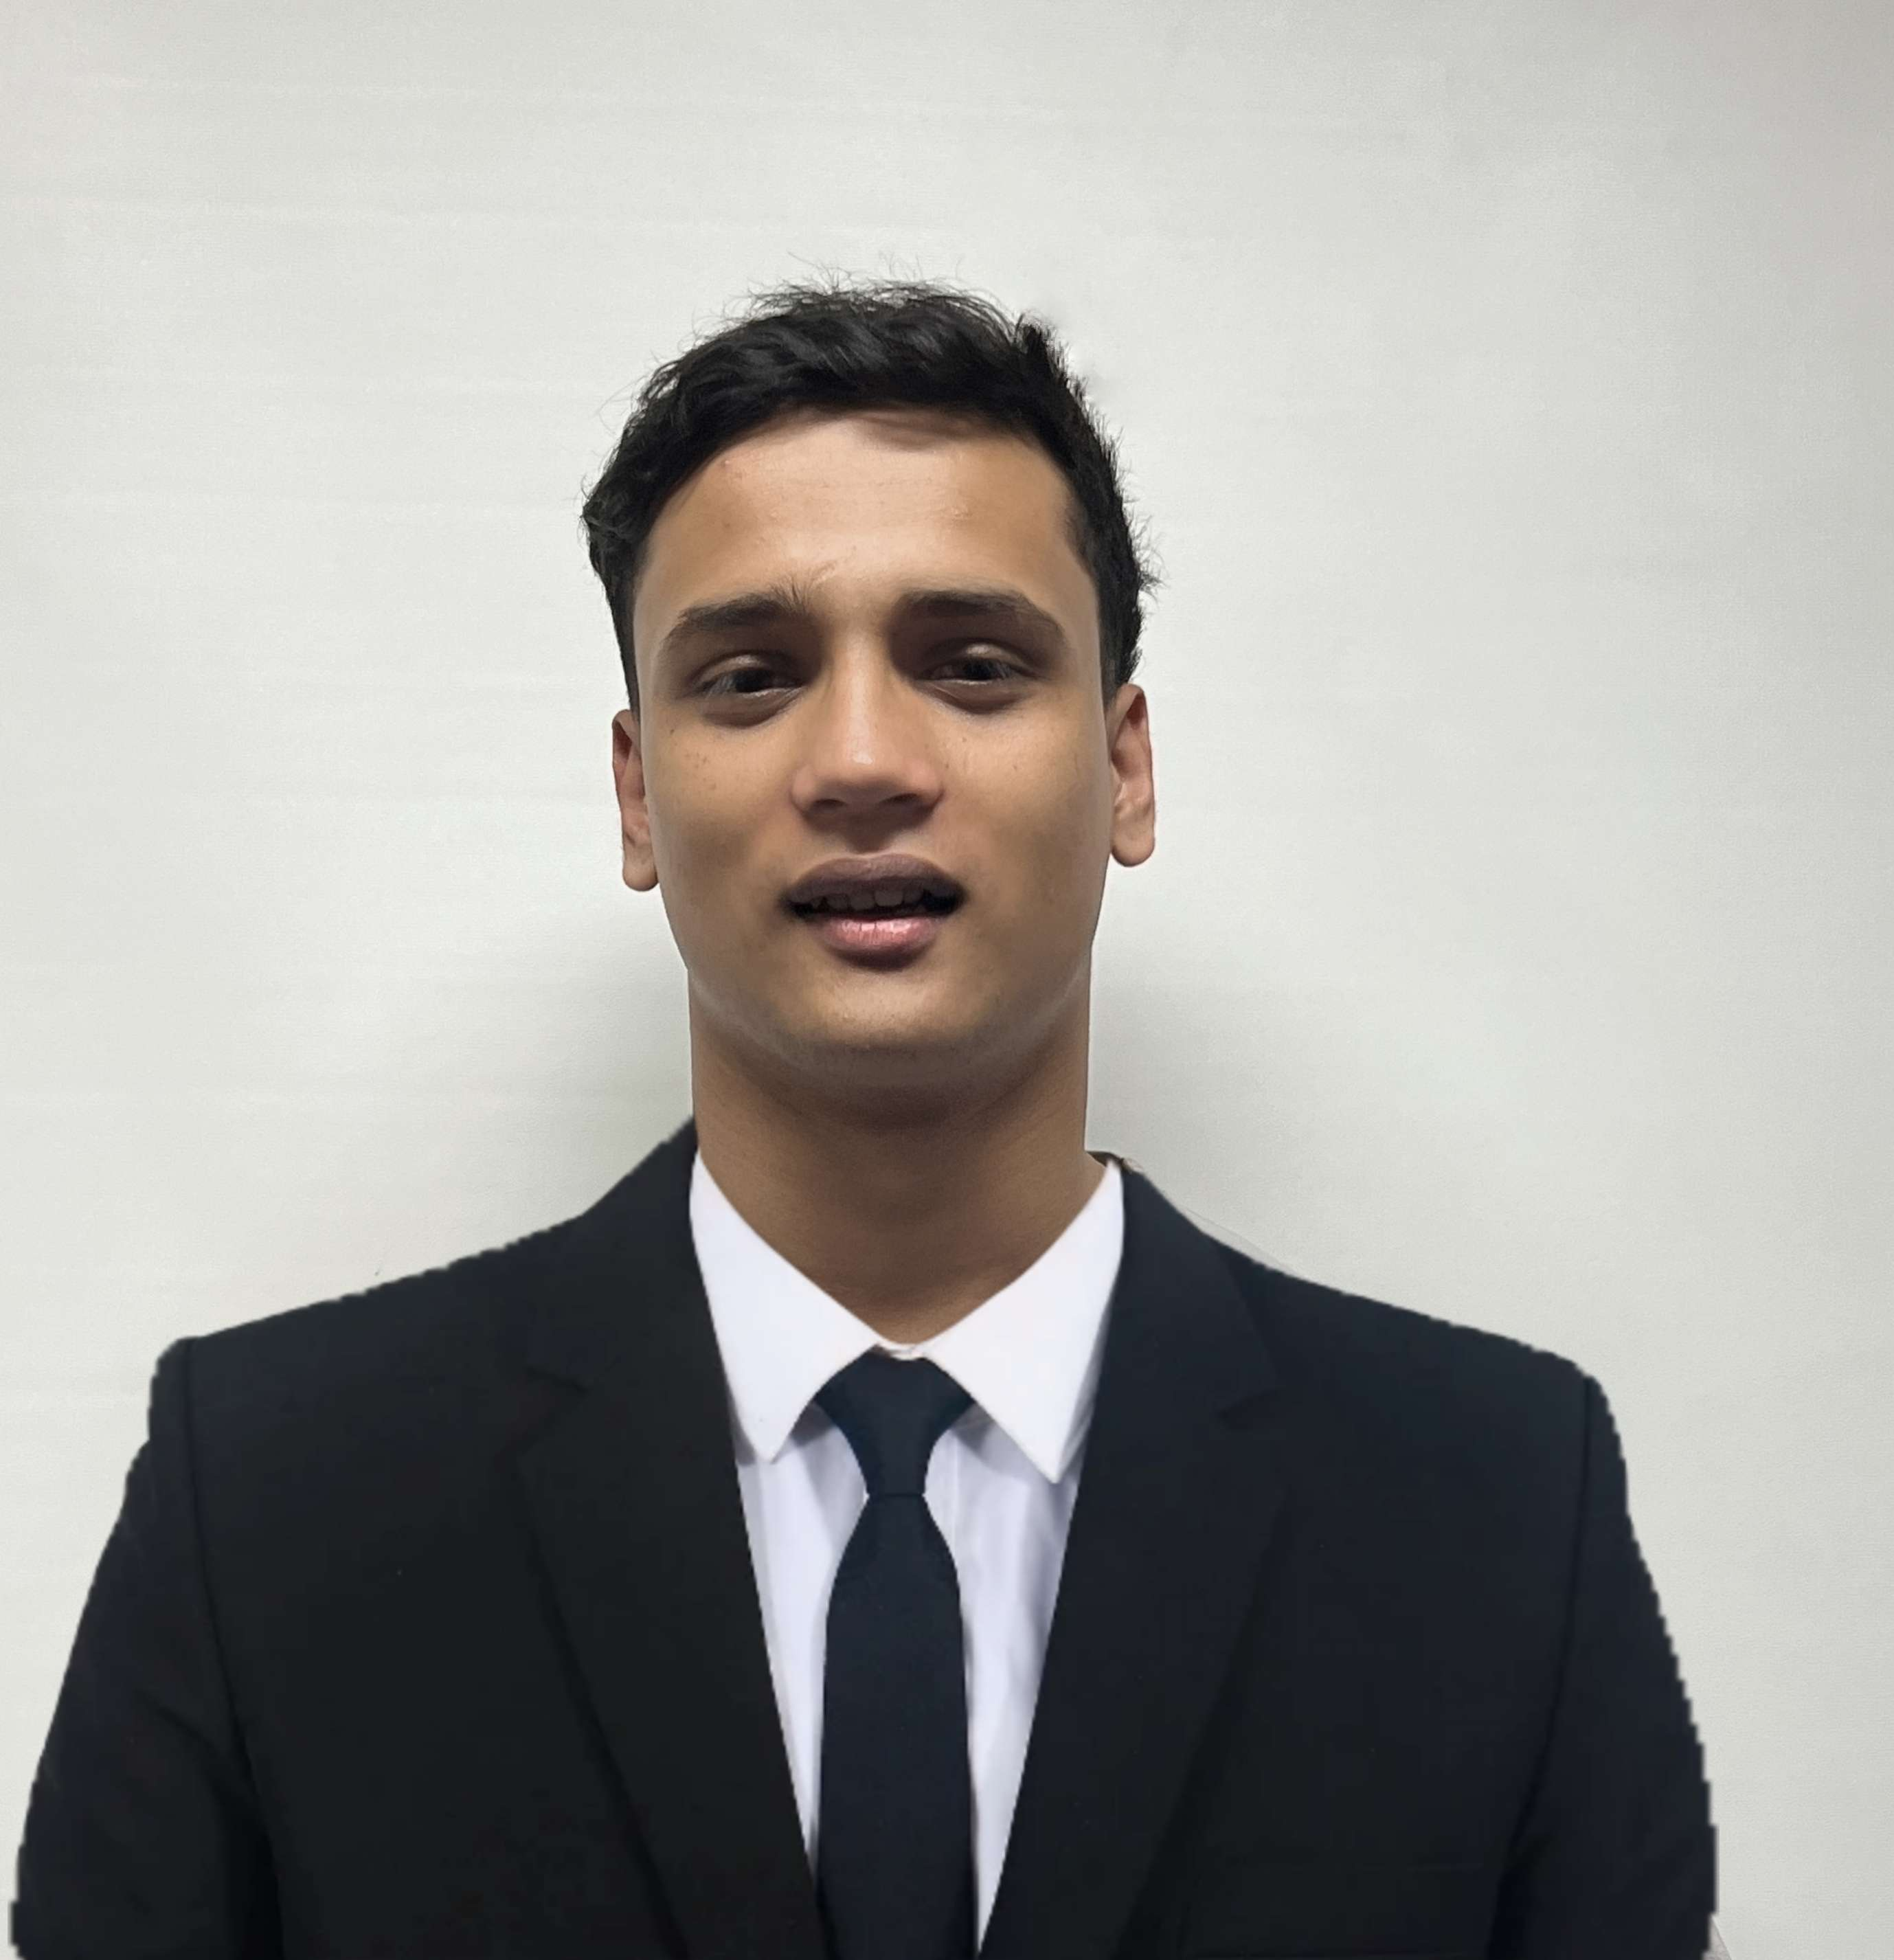




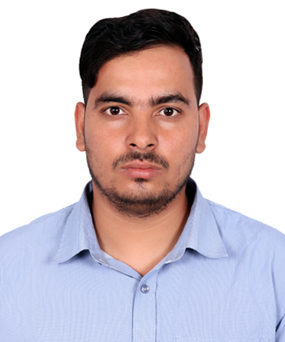
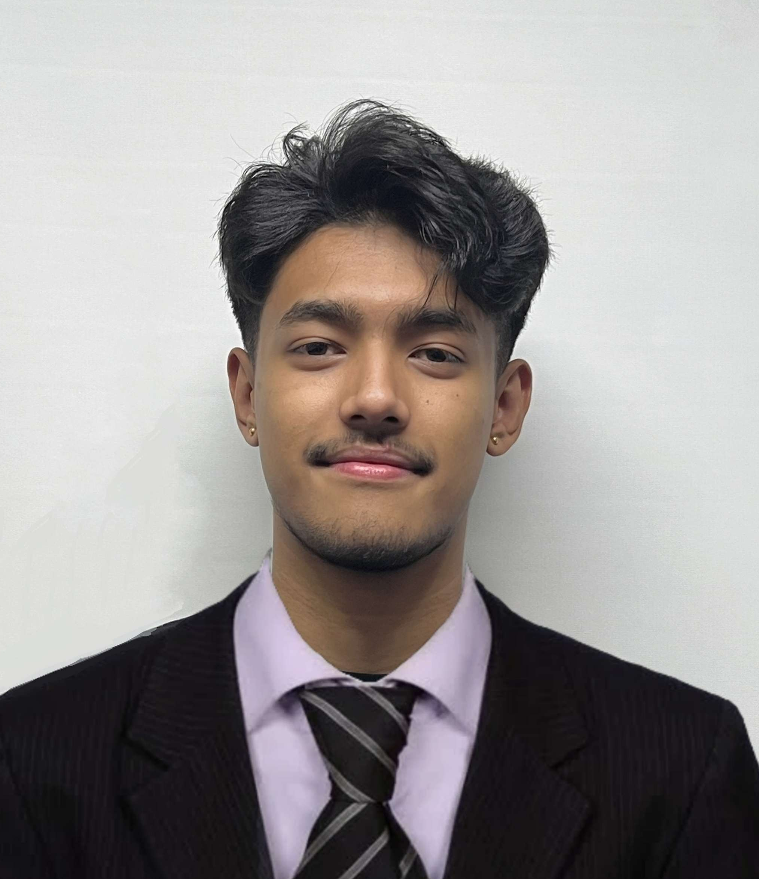
Our team
Abhishek Poudel
Plant
Shasank Shrestha
Amulya Shrestha
Co-Ordinator
Resource Investigator
Soya Shrestha
Team Worker
Biliyas Maharjan
Team Worker
Sushan Bhandari
Implementer
Biraj Shrestha
Co-Ordinator

Slide 3

TABLE OF CONTENT
Initiation Phase
Team Contract
Project Charter
Planning Phase
Belbin Analysis
MS Project
Execution Phase
Database Design
Use Case Diagram
Website Demonstration
Customer Interface
Trader Interface
Admin Interface
3

Slide 4

INITIATION PHASE
Project Charter
Team Contract
4

Slide 5












PROJECT CHARTER
TEAM CONTRACT
Version Control
Team Structure
Project Justification
Team Procedure
Project Scope
Team Participation
Estimated Budget
Personal Accountability
Consequences of breach of contract
Duration
Certification by team members
Roles and Responsibility

Slide 6
PLANNING PHASE
Belbin Analysis
MS Project

Slide 7
Belbin Analysis
Team Members | Primary Role | Secondary Role | Least likely Role
Abhishek Poudel | Plant | Resource Investigator | Shaper
Amulya Shrestha | Resource Investigator | Plant | Shaper
Biliyas Maharjan | Team Worker | Implementer | Monitor Evaluator
Biraj Shrestha | Co-Ordinator | Complete Finisher | Plant
Shasank Shrestha | Co-Ordinator | Specialist | Complete Finisher
Soya Shrestha | Team Worker | Monitor Evaluator | Shaper
Sushan Bhandari | Implemeter | Co-Ordinator | Specialist

Slide 8
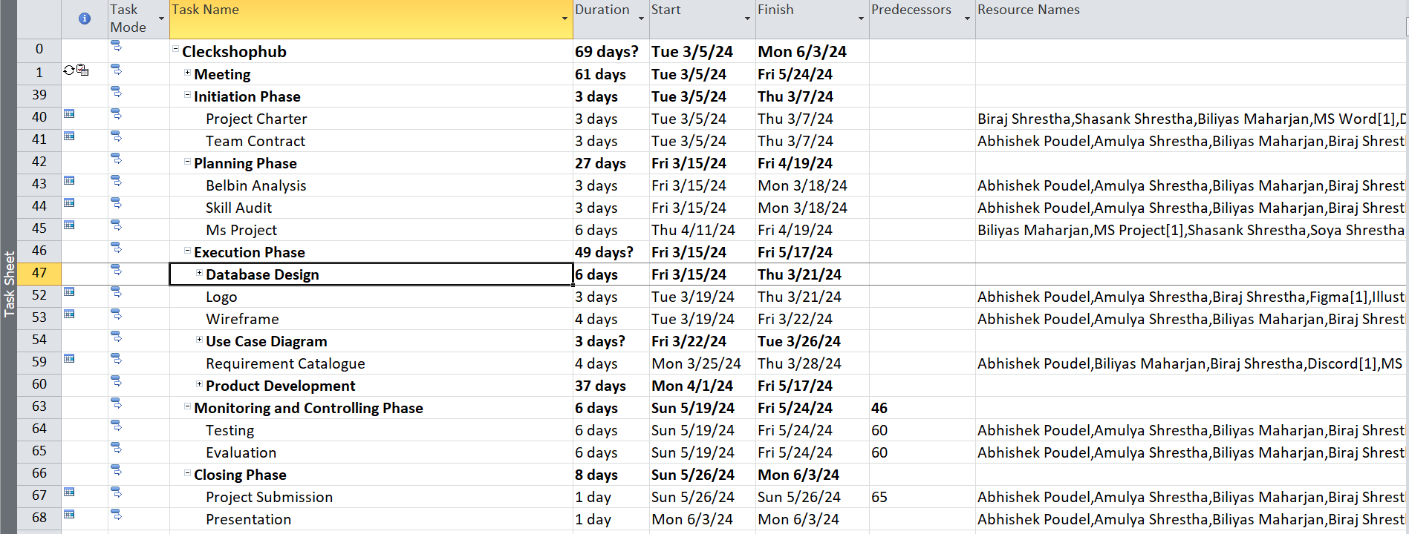
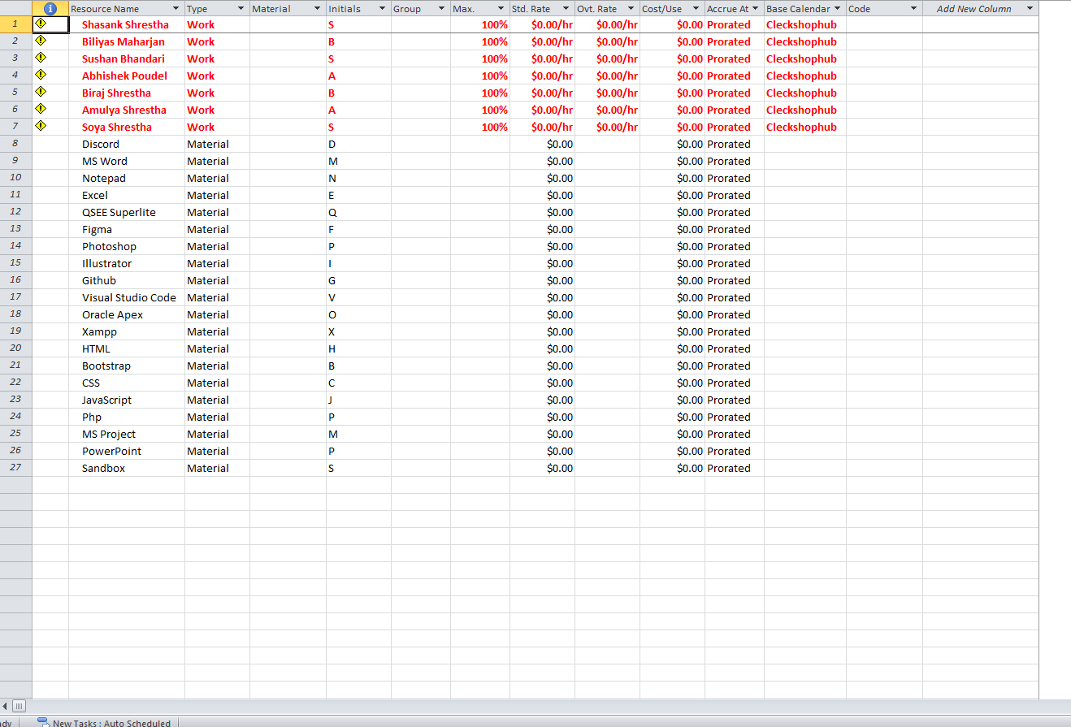
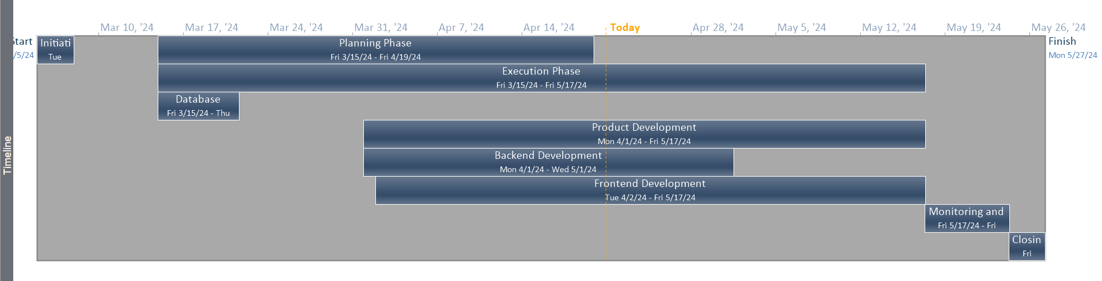
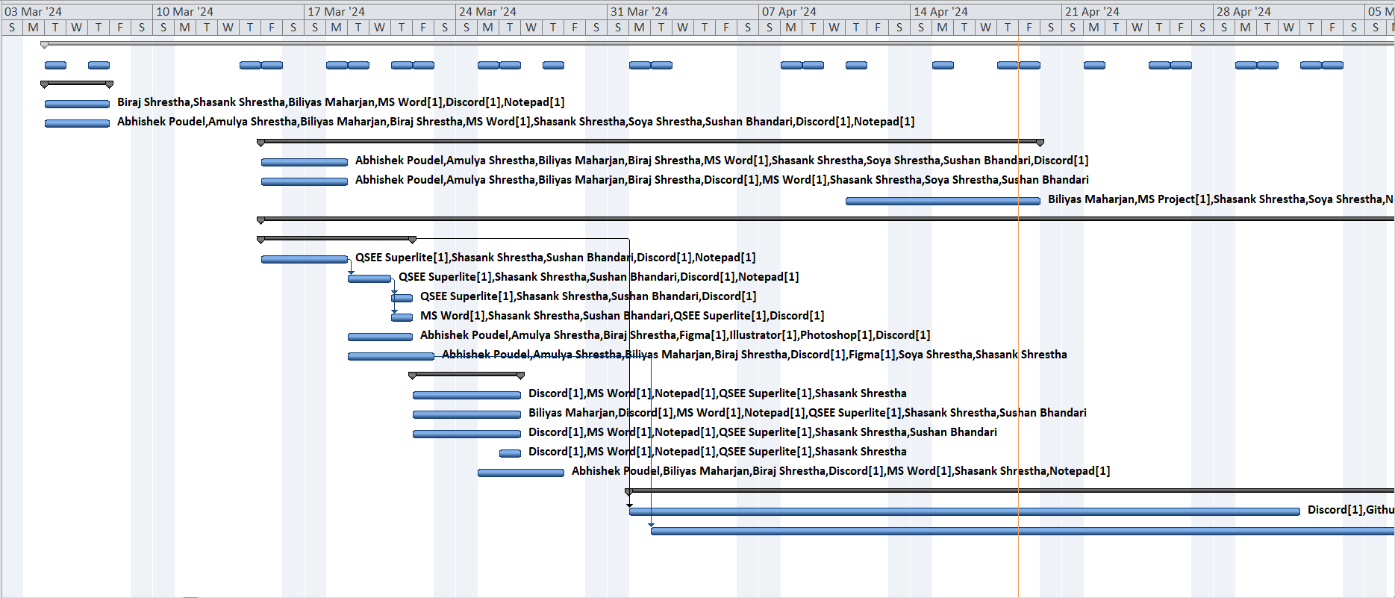
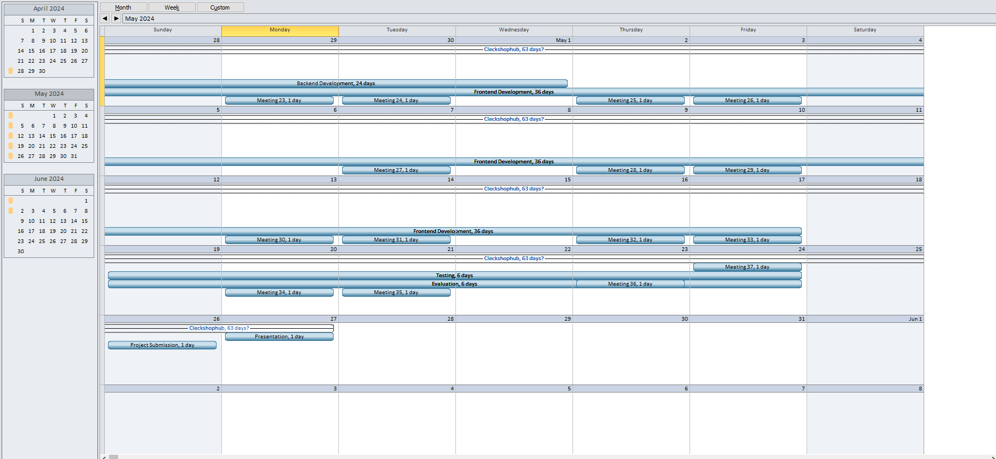
MS PROJECT
TASK SHEET
RESOURCE SHEET
TIMELINE
GANTT CHART
CALENDAR
8

Slide 9
EXECUTION PHASE
Database Design
Use Case Diagram
Requirement Catalogue

Slide 10
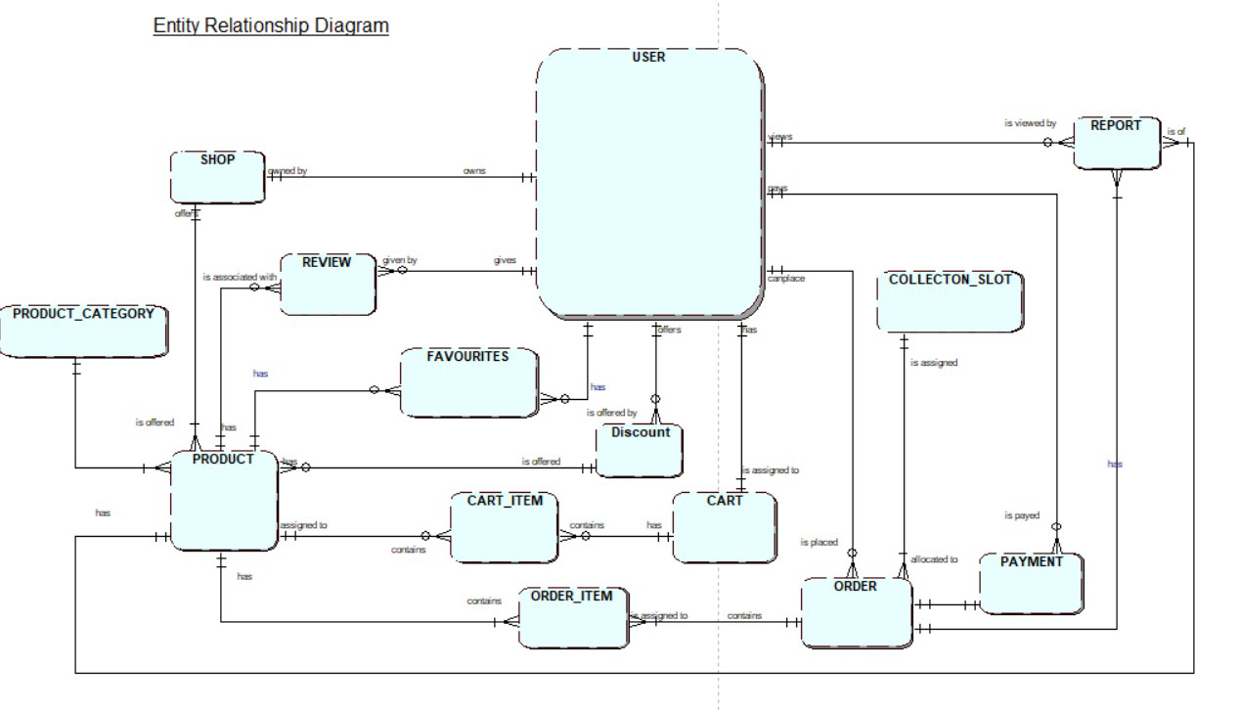
ERD

Slide 11
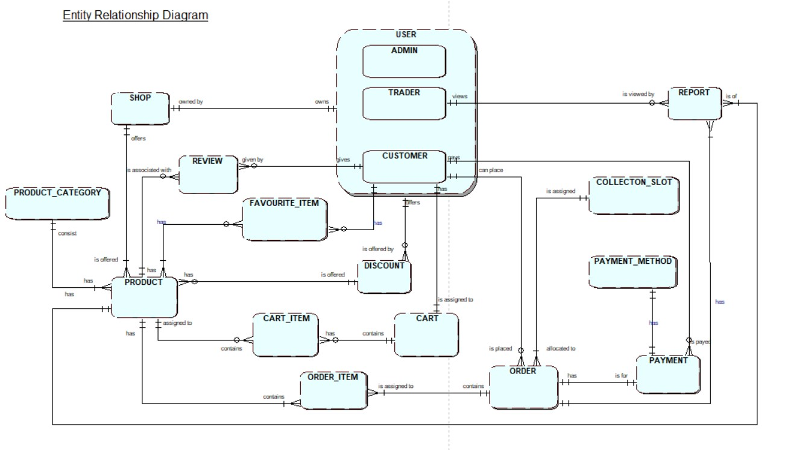
EERD

Slide 12
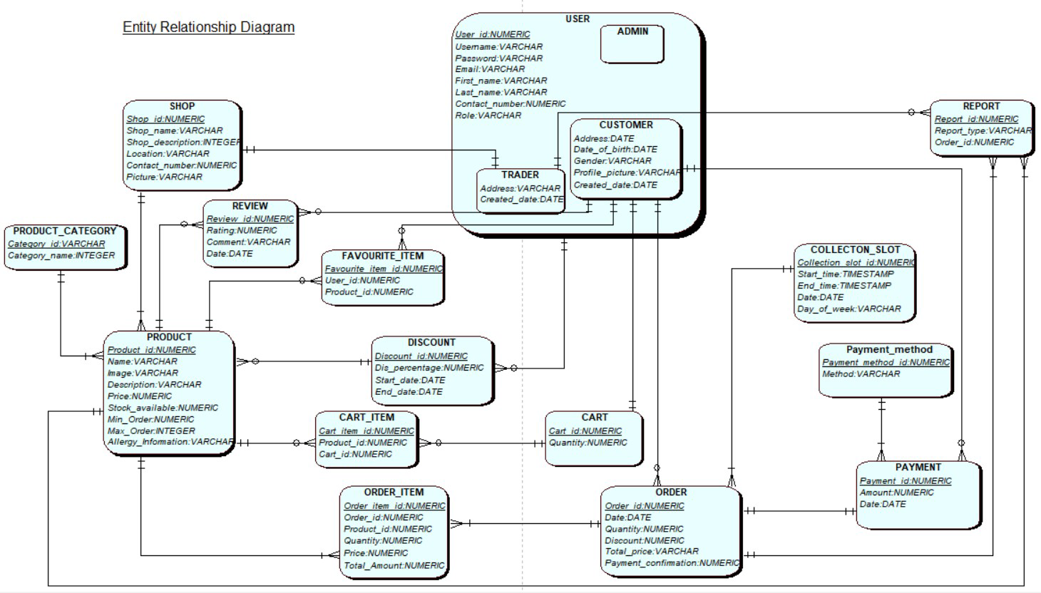
COMPOSITE ERD

Slide 13
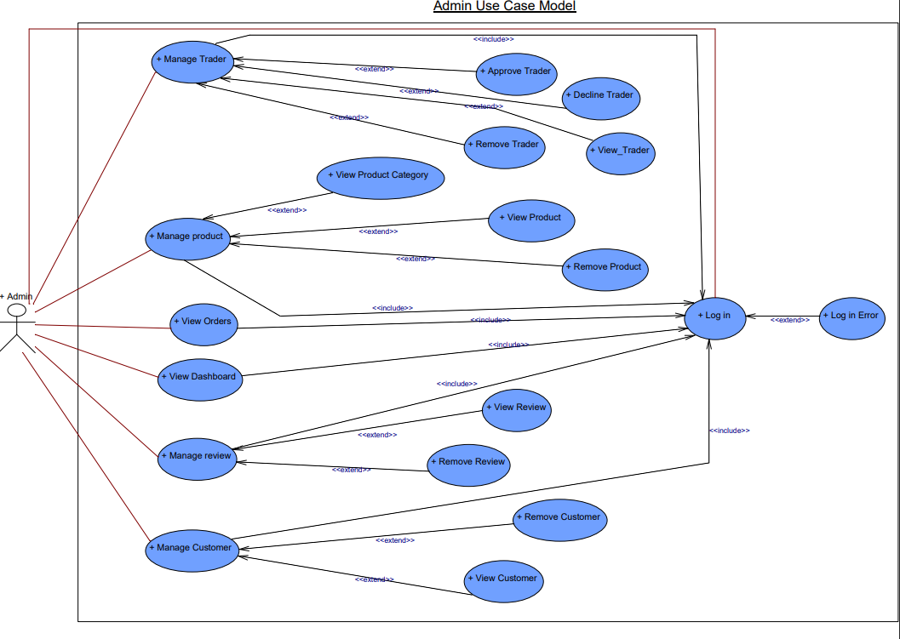
ADMIN USE CASE DIAGRAM

Slide 14
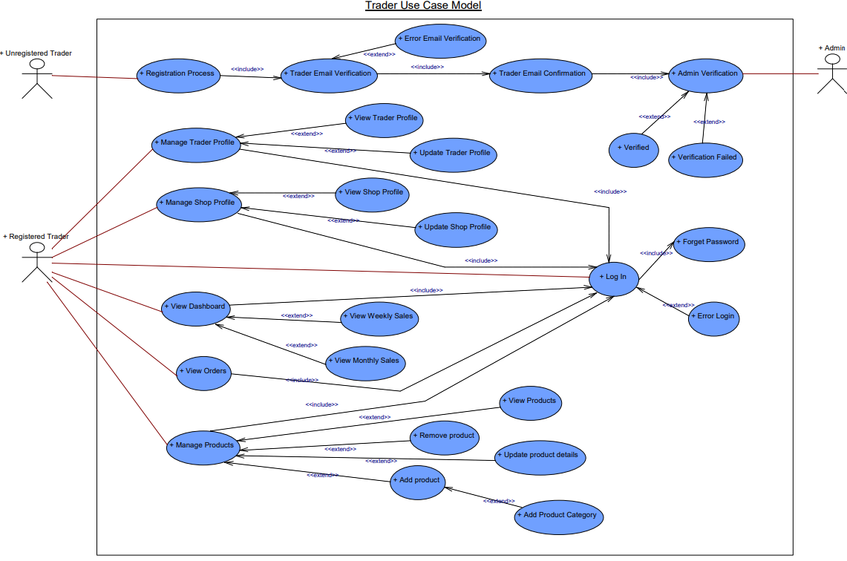
TRADER USE CASE DIAGRAM

Slide 15
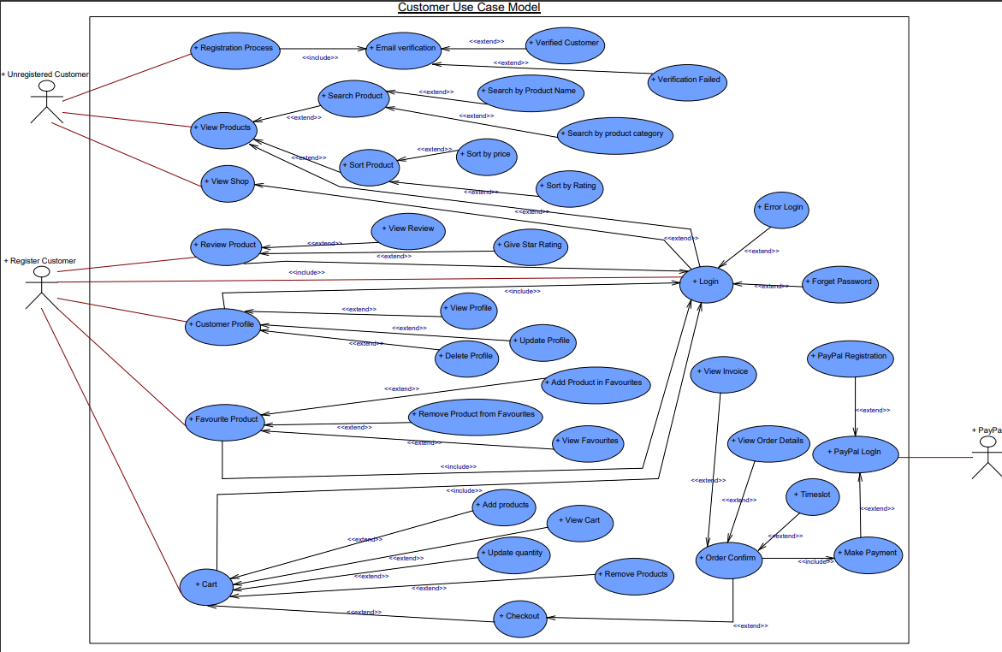
CUSTOMER USE CASE DIAGRAM

Slide 16
Website Demonstration
Customer Interface
Trader Interface
Admin Interface
16

Slide 17
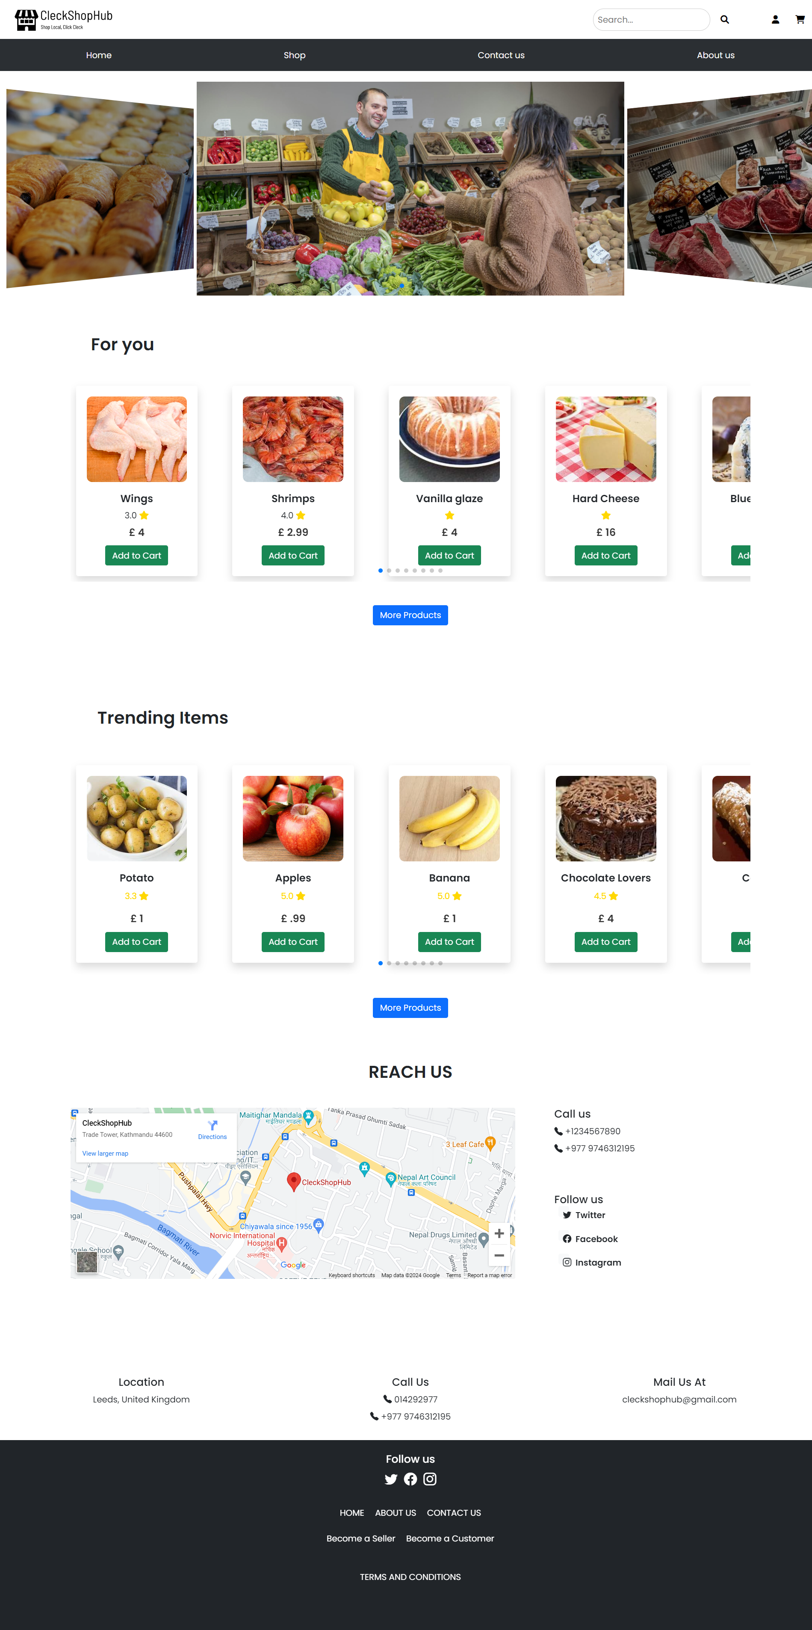
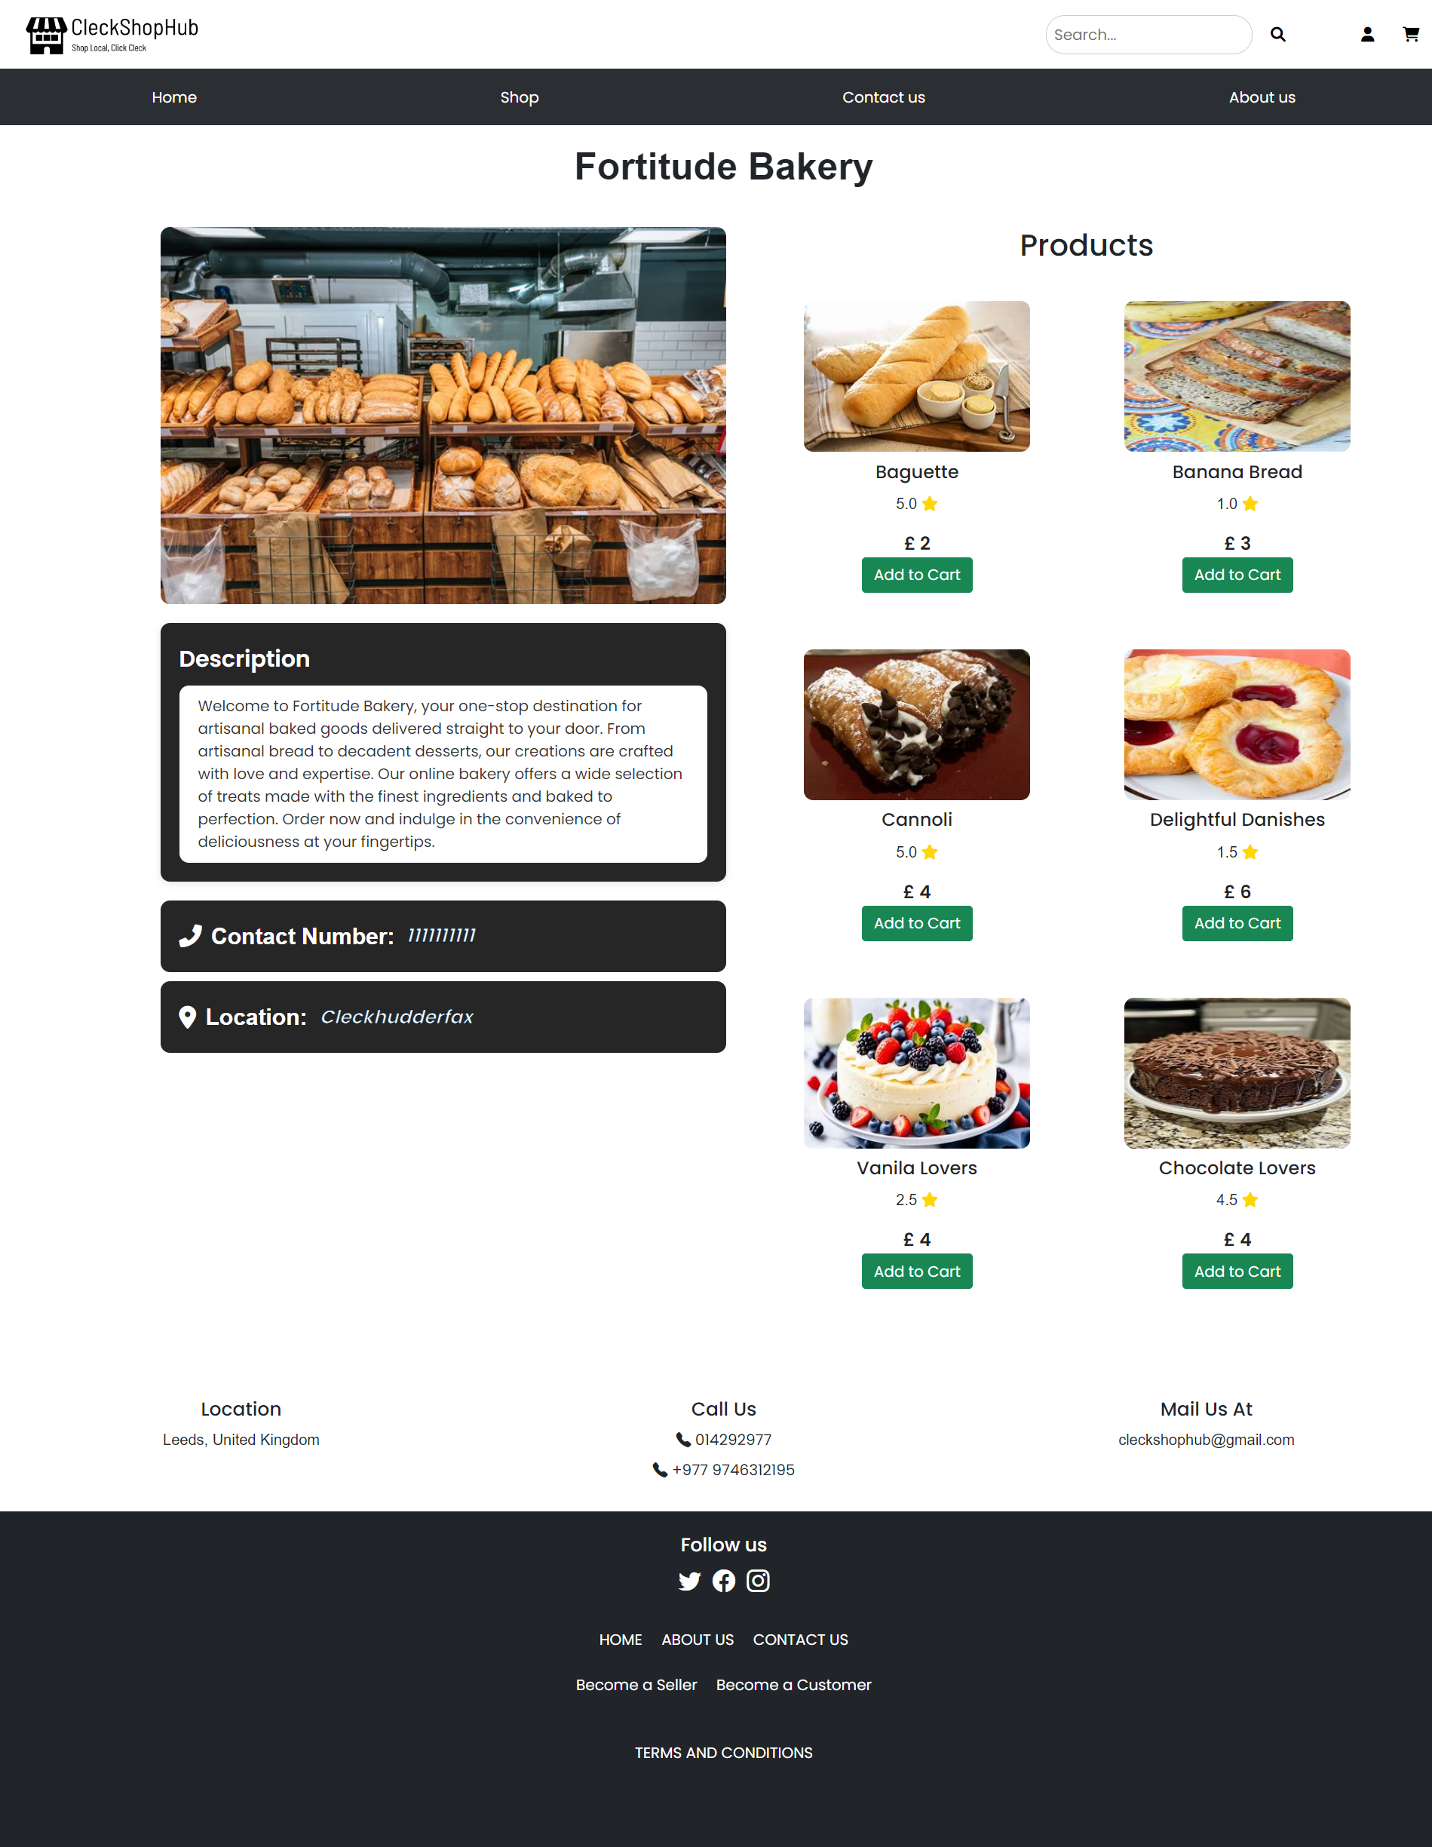
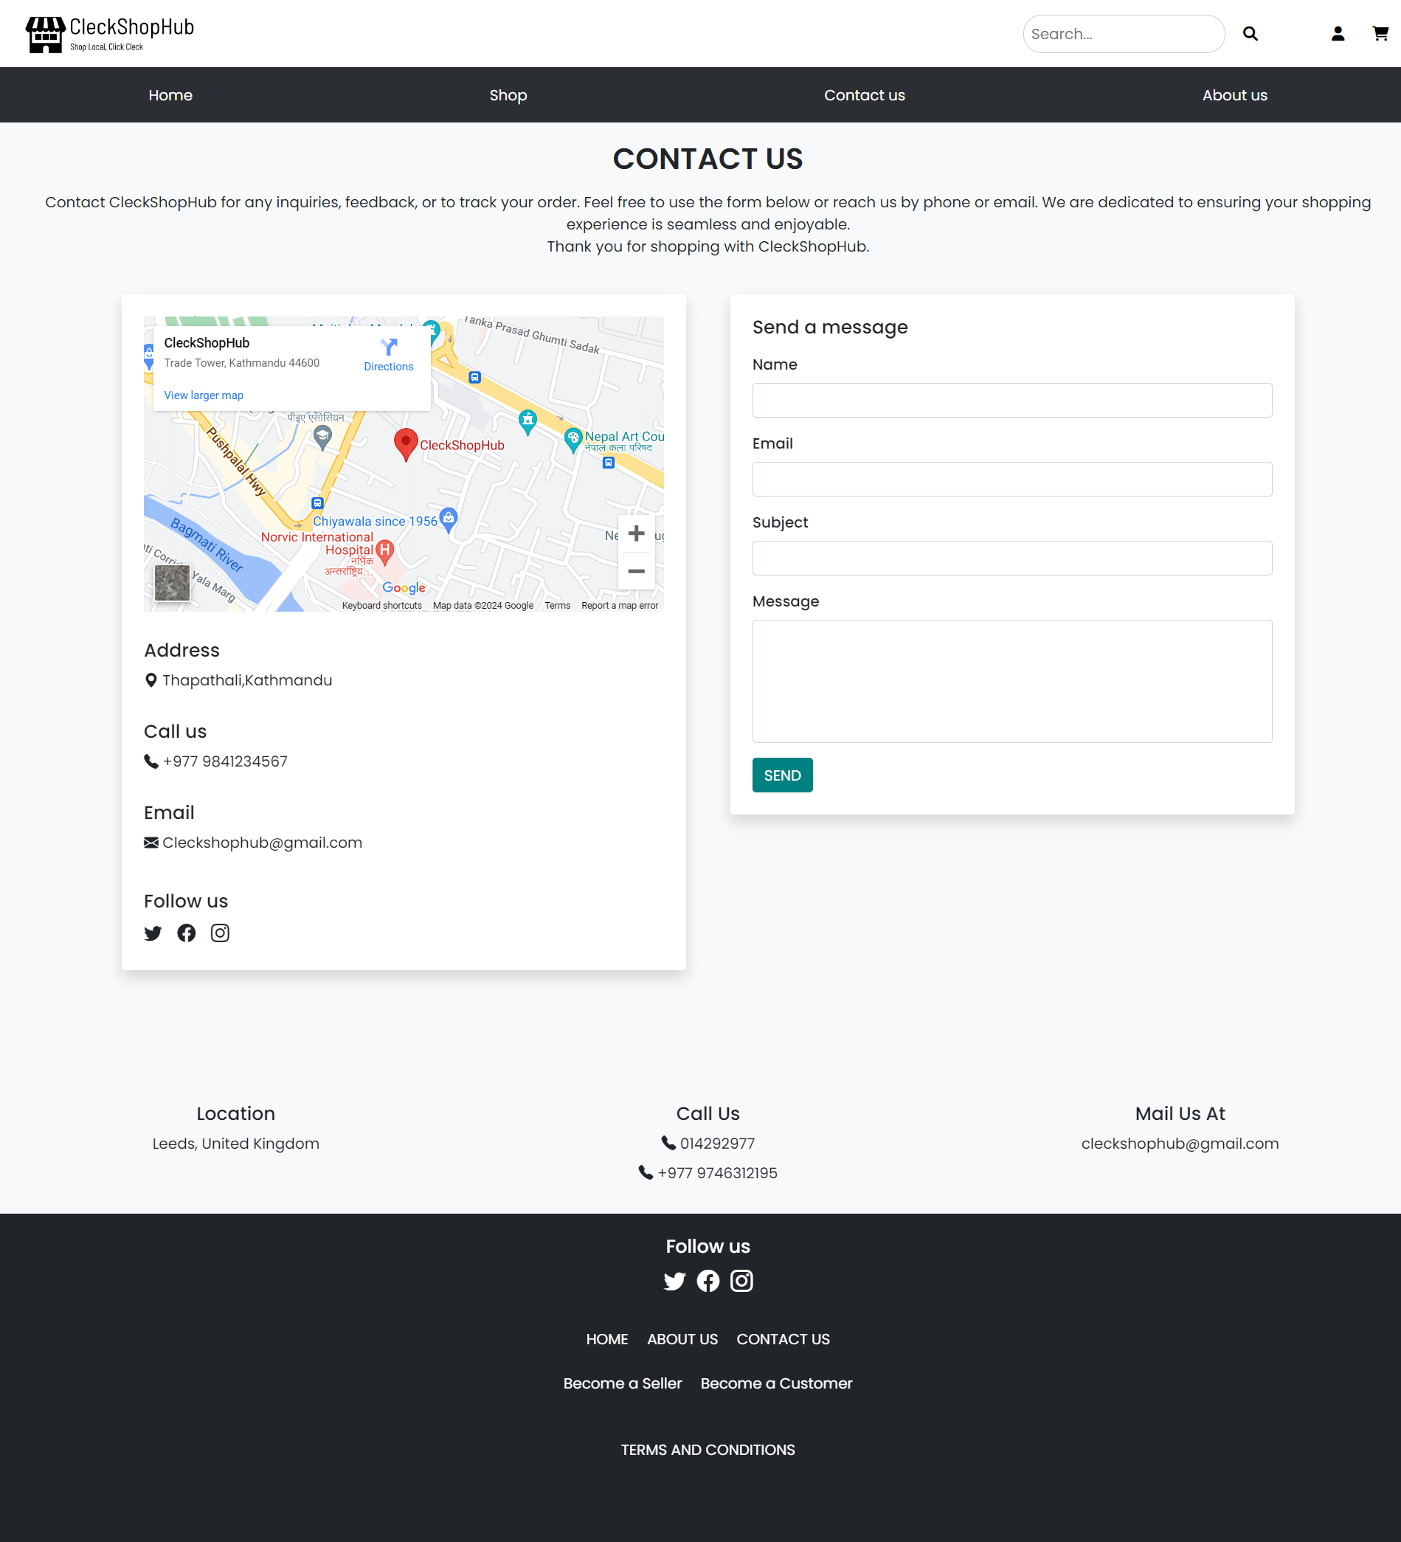
USER PAGES

Slide 18
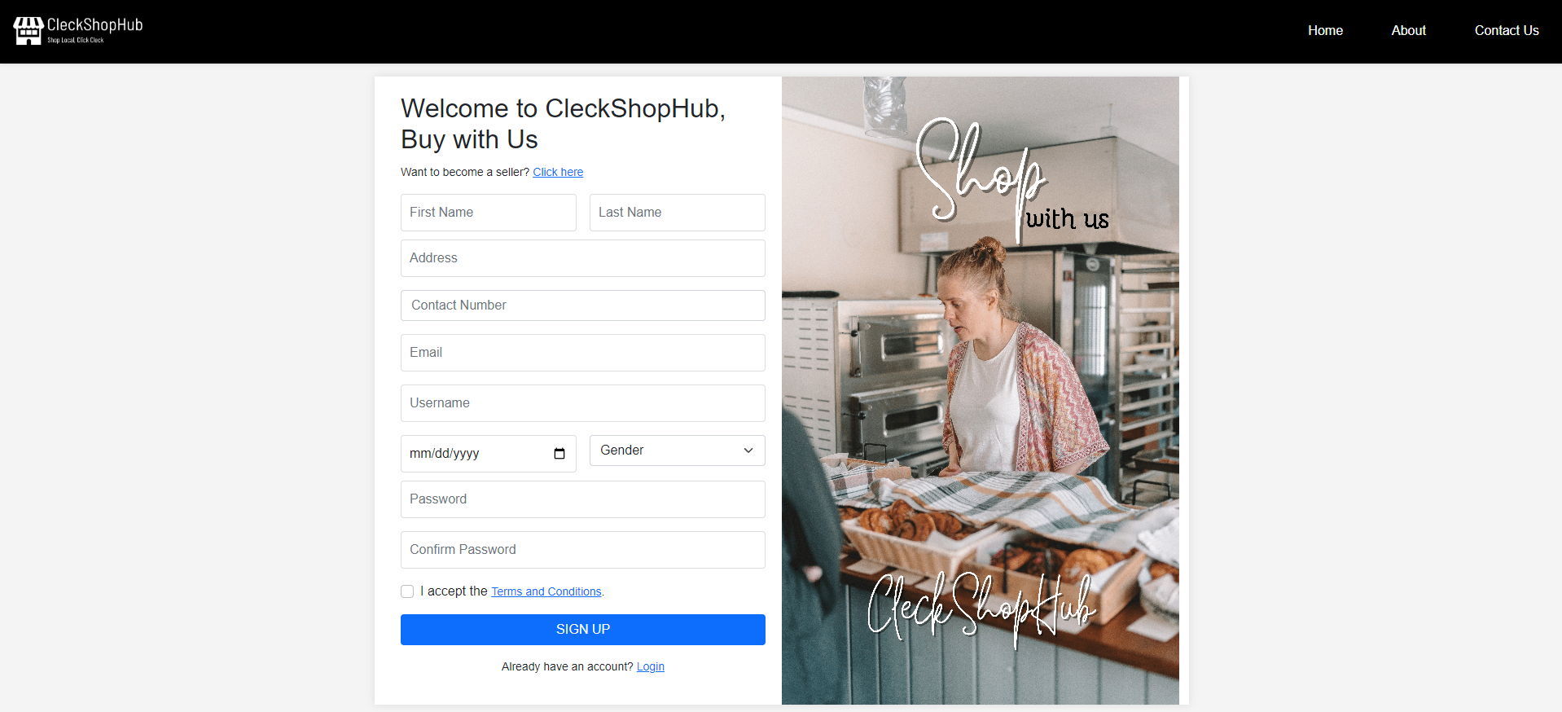
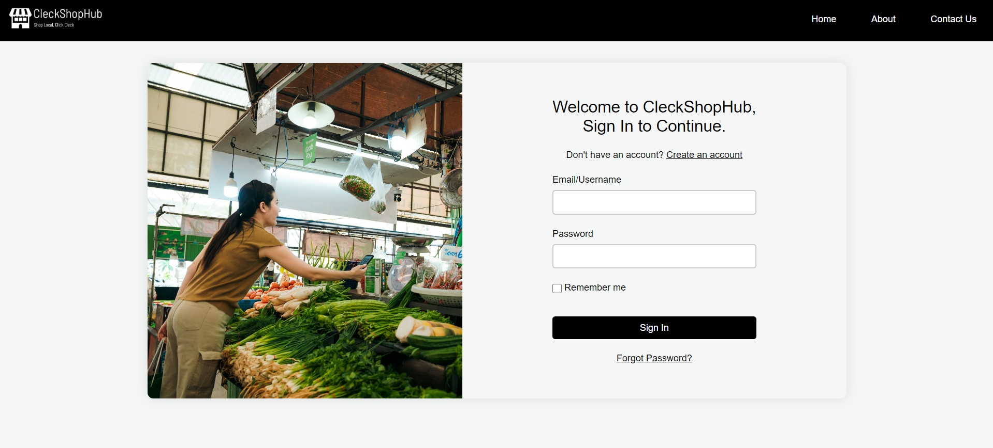
LOGIN PAGE
SIGN UP PAGE

Slide 19
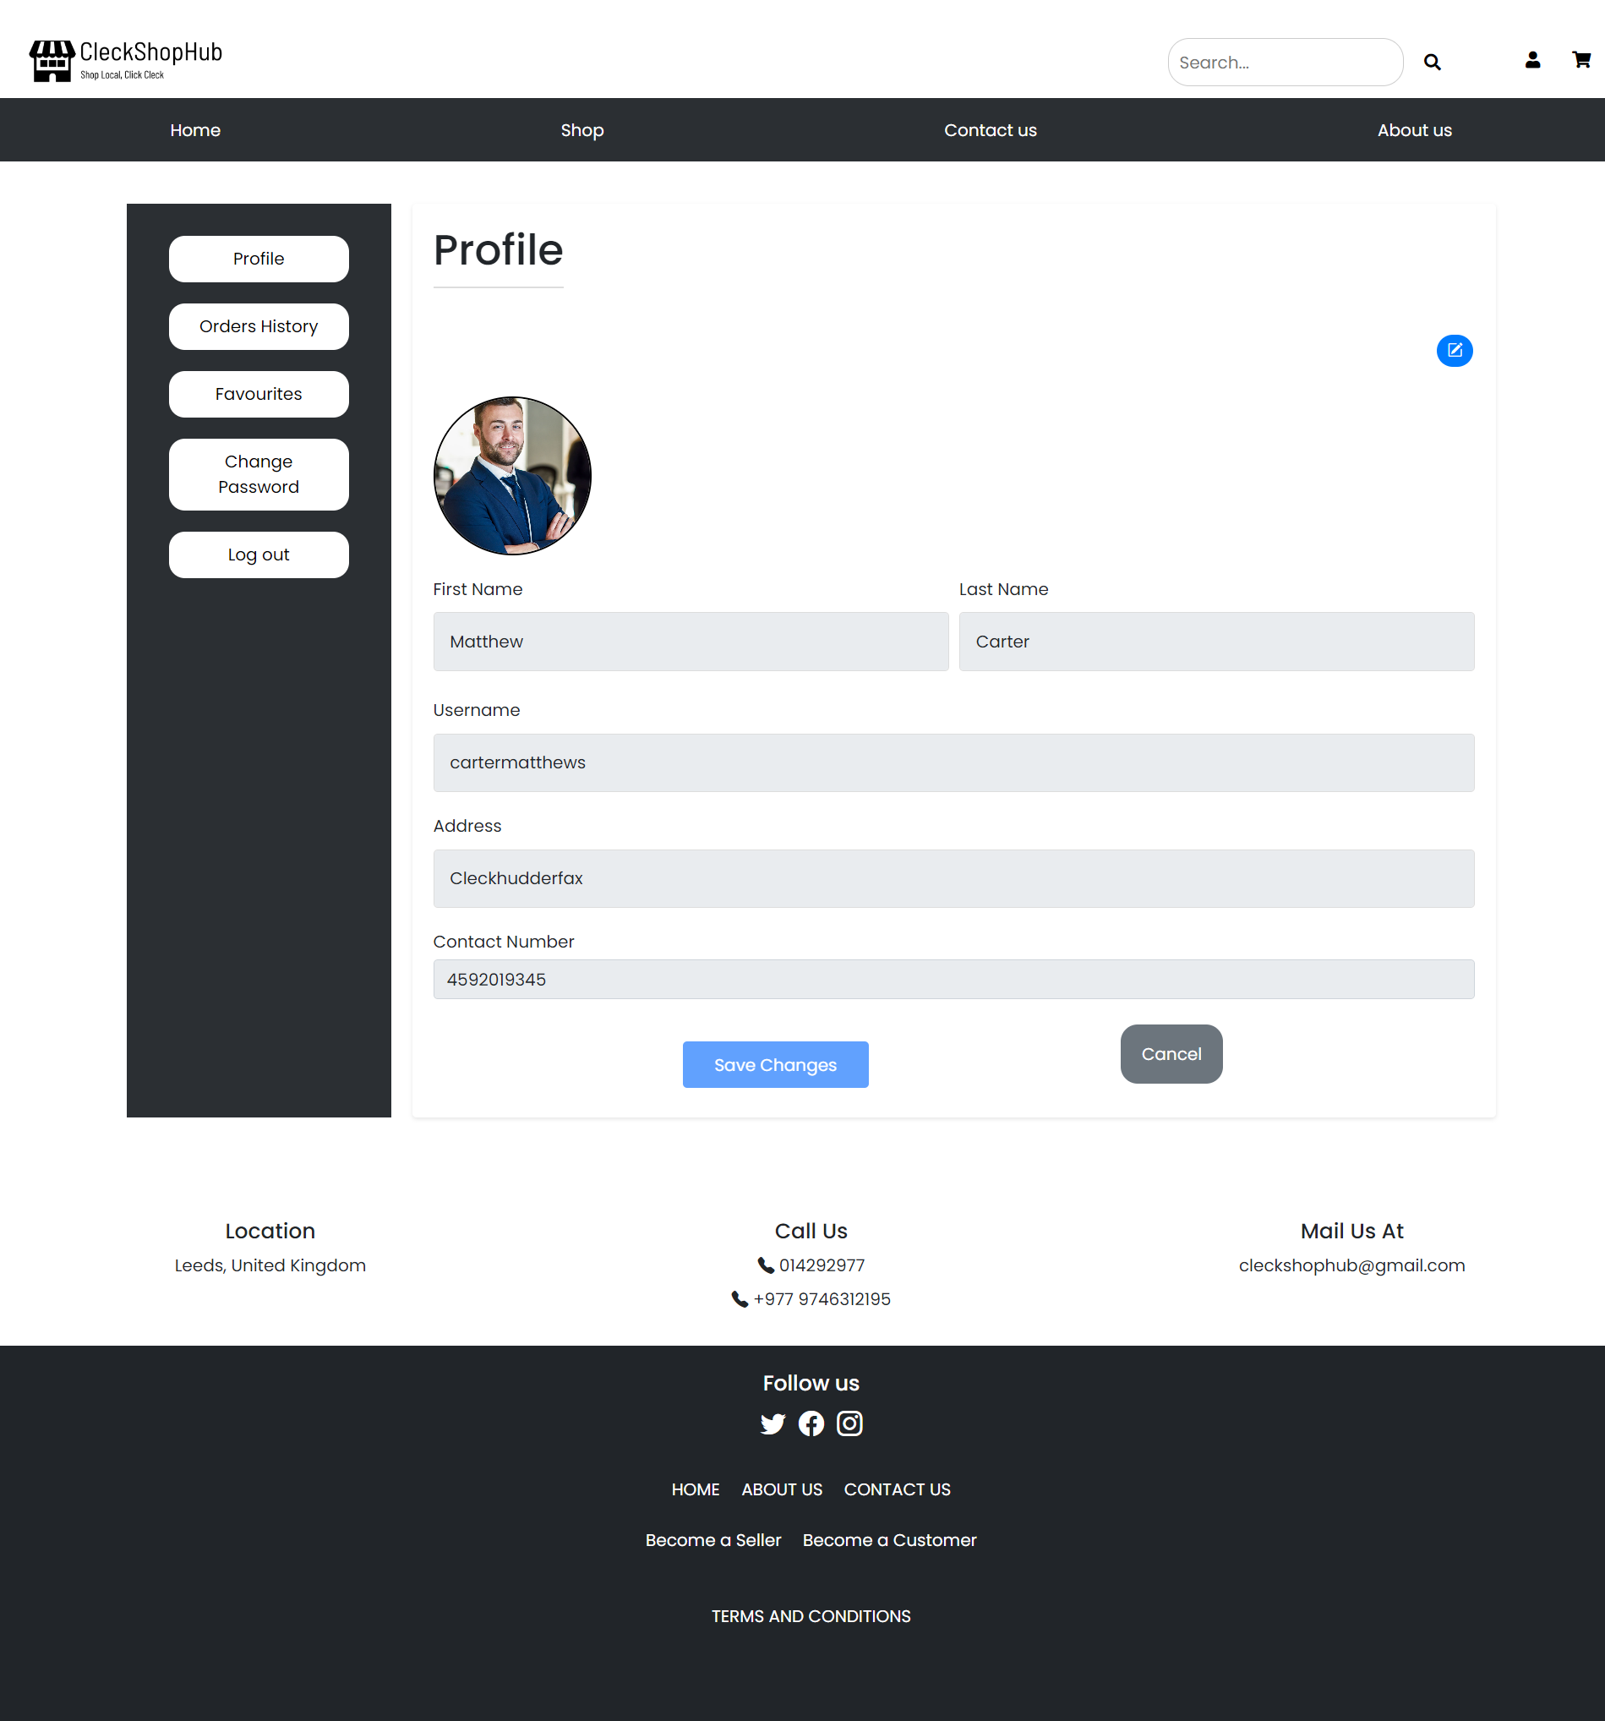
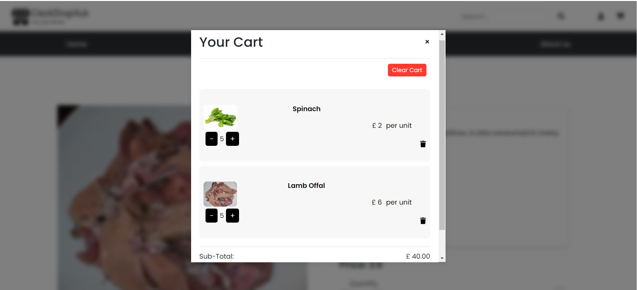
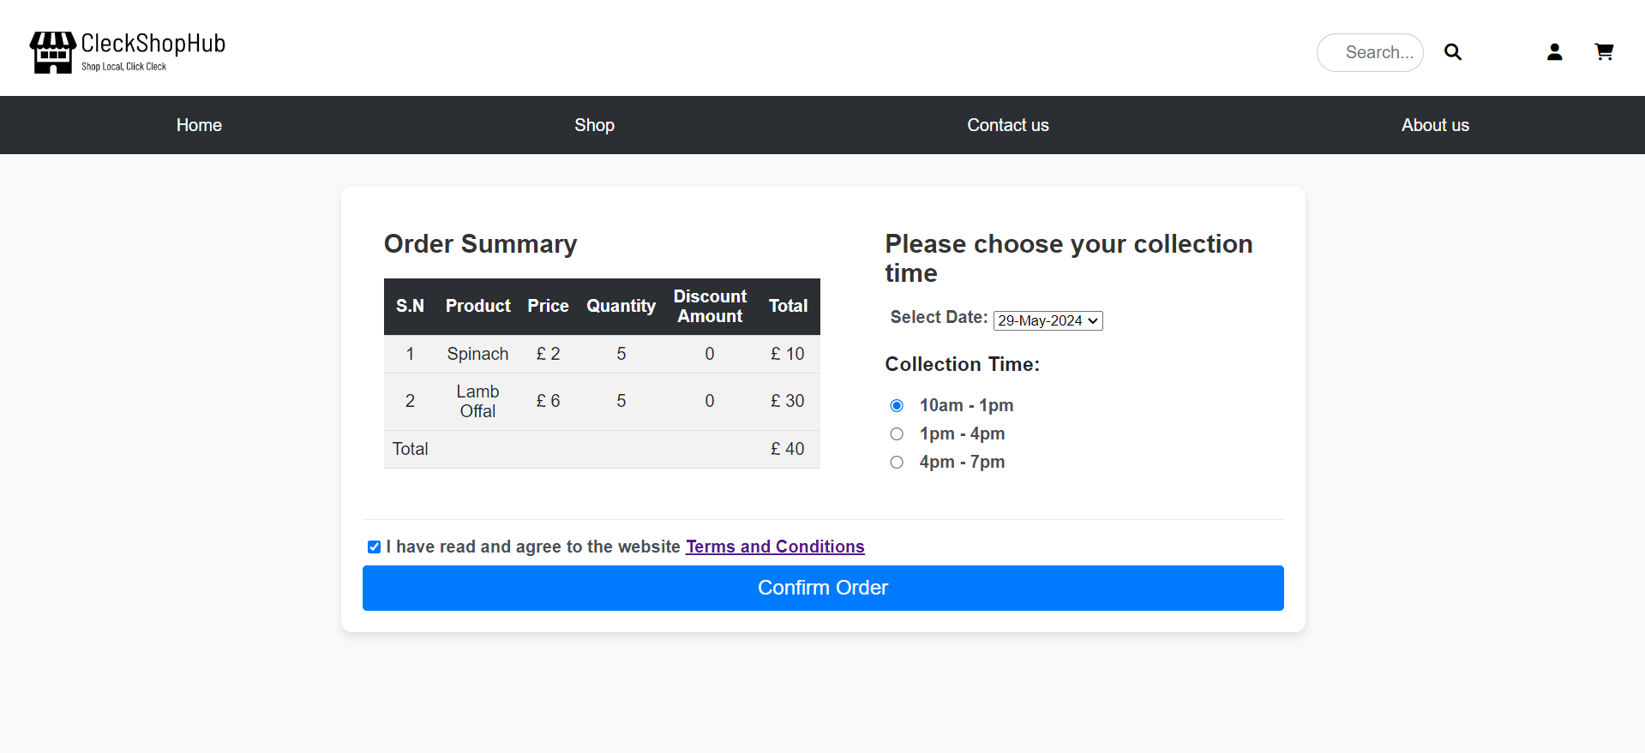
Customer Interface

Slide 20
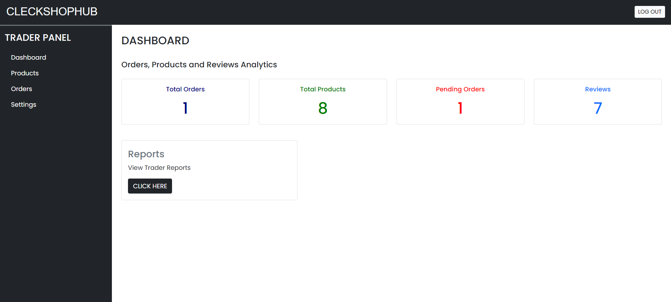
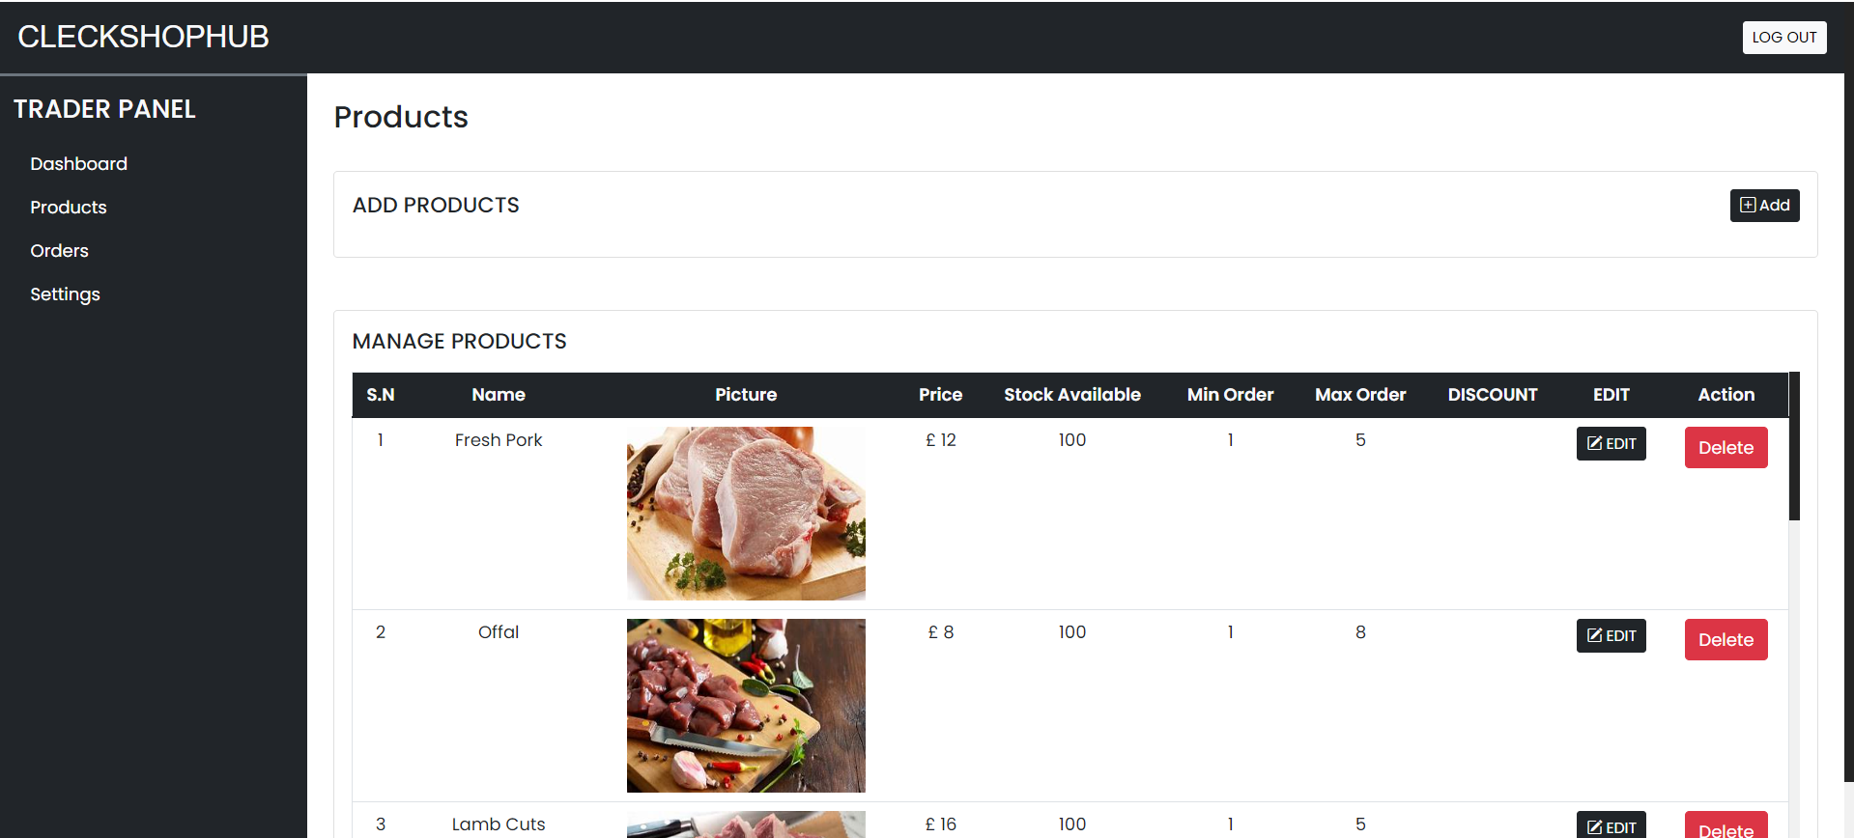
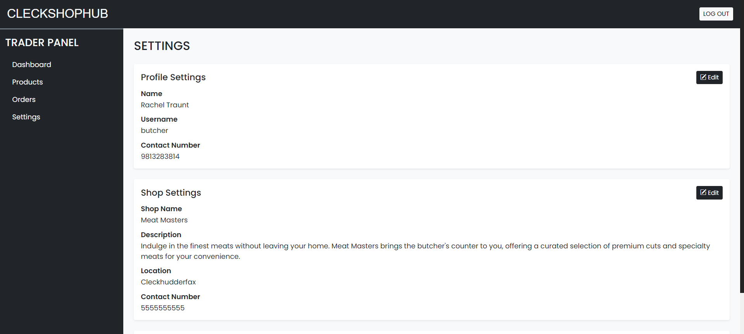
Trader Interface

Slide 21
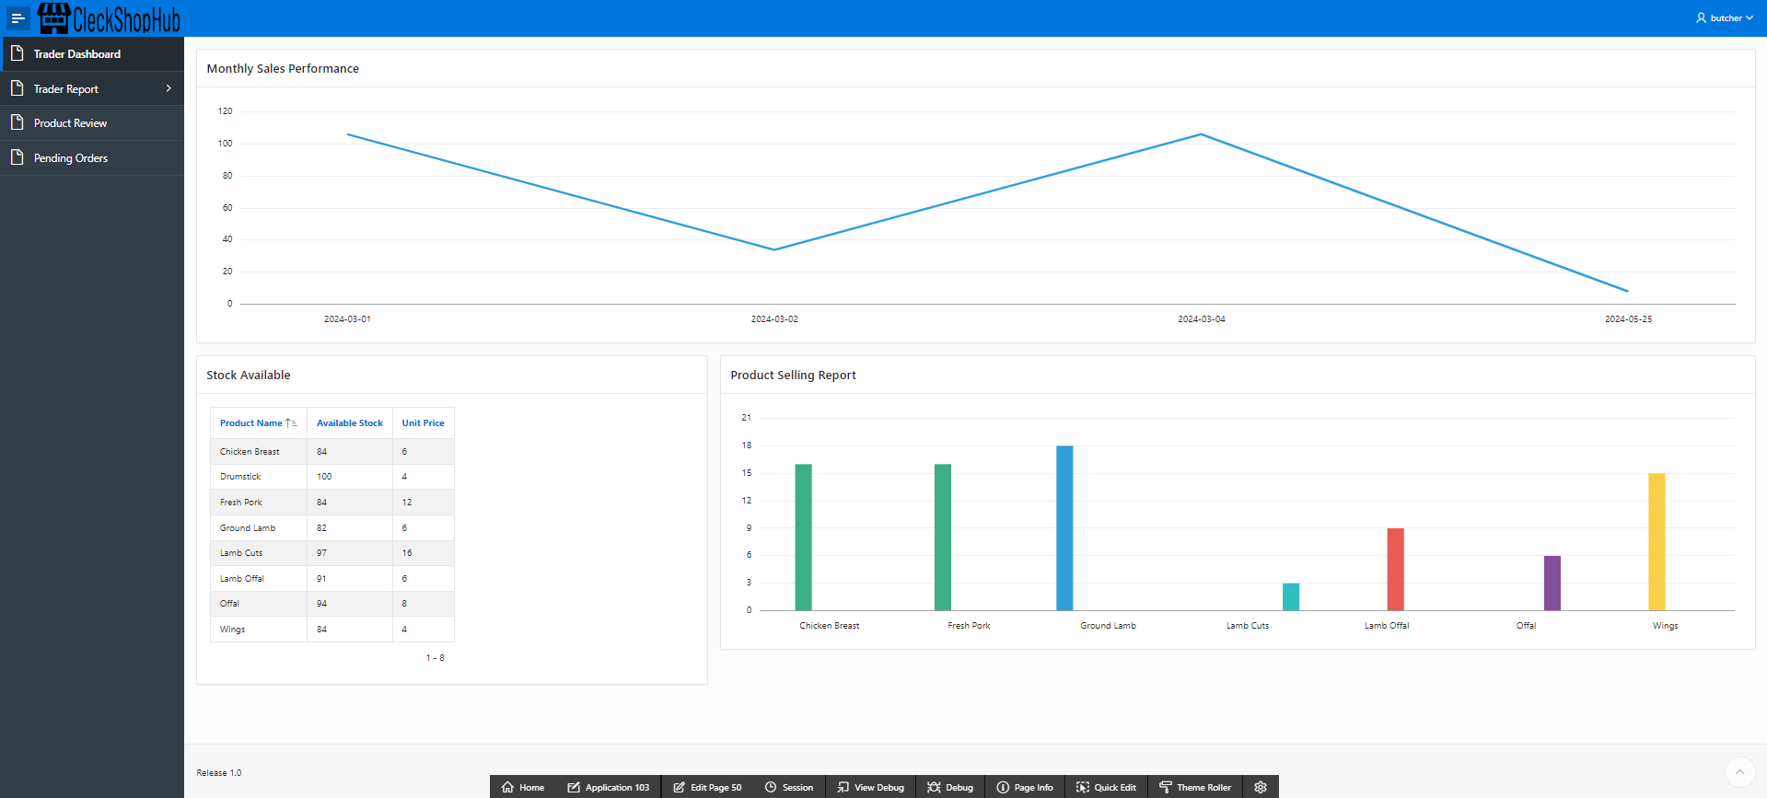
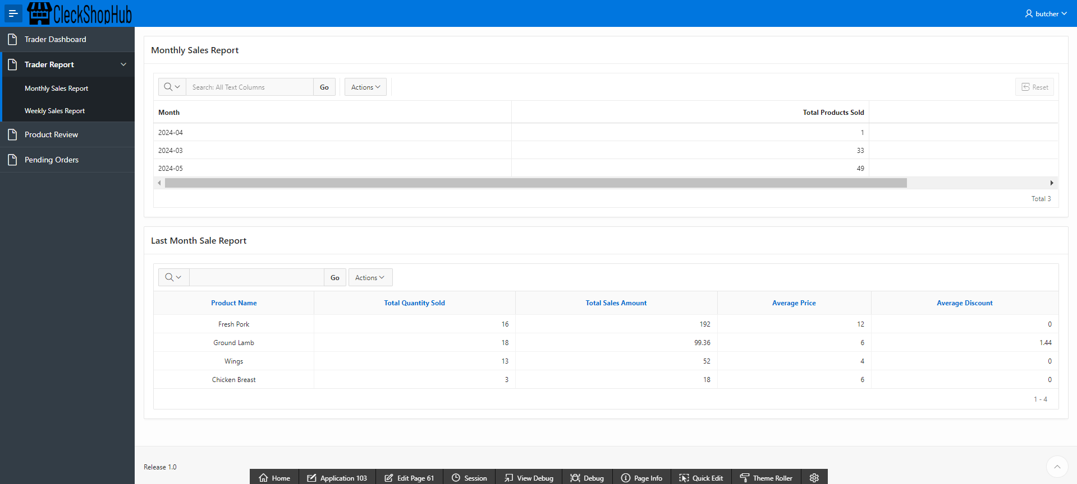
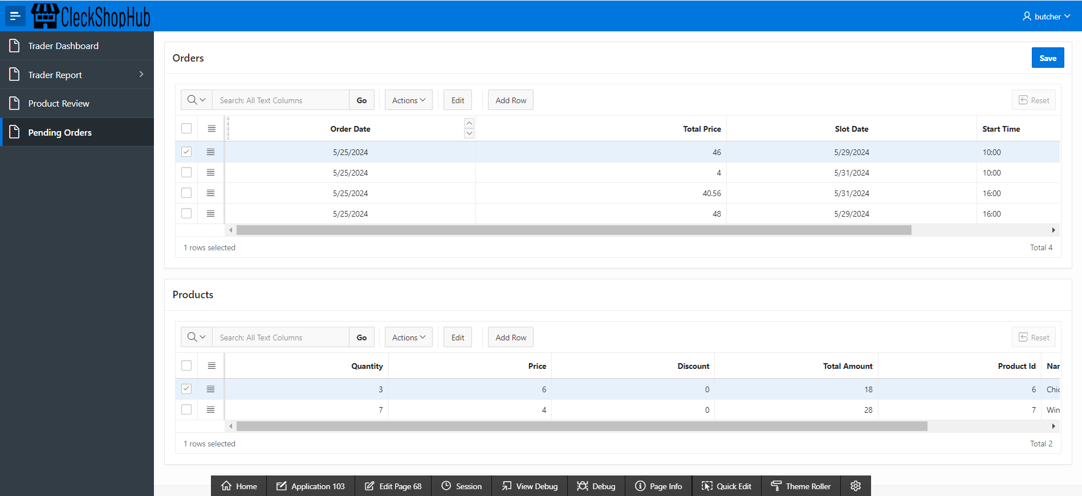
Trader Apex

Slide 22
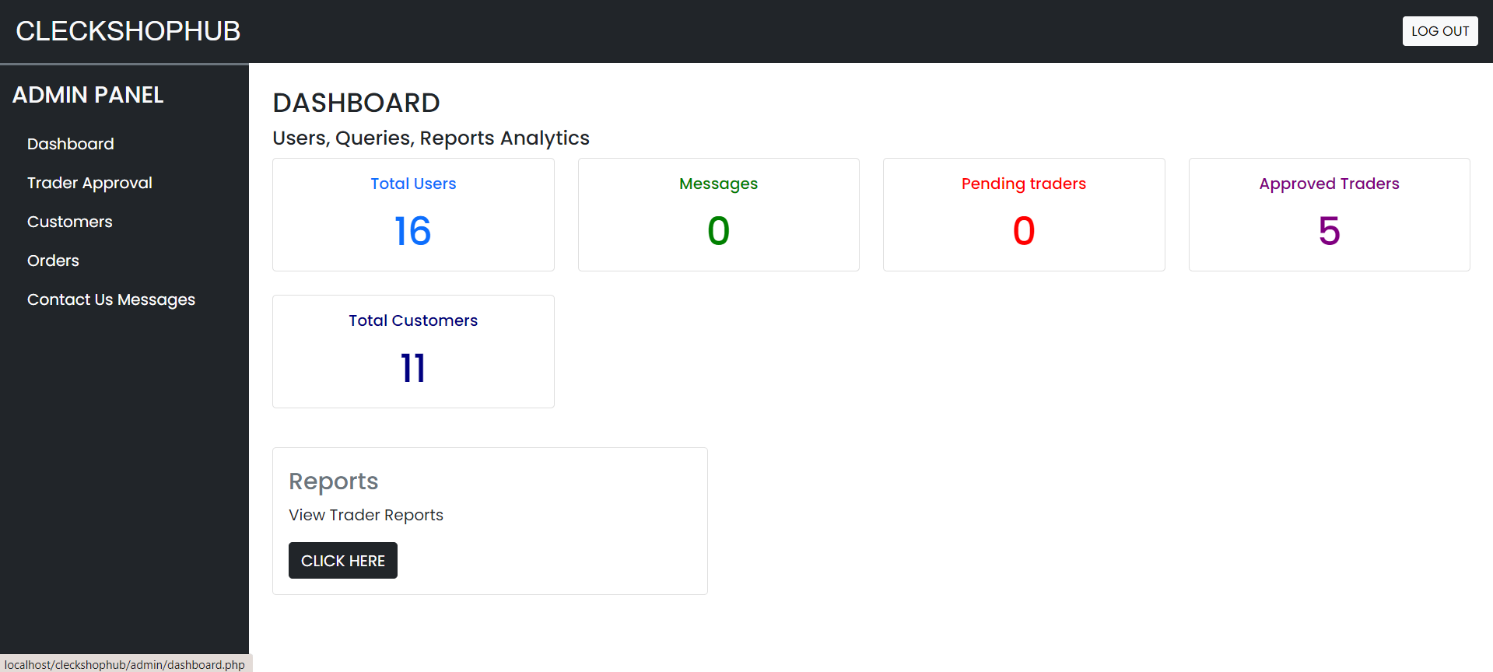
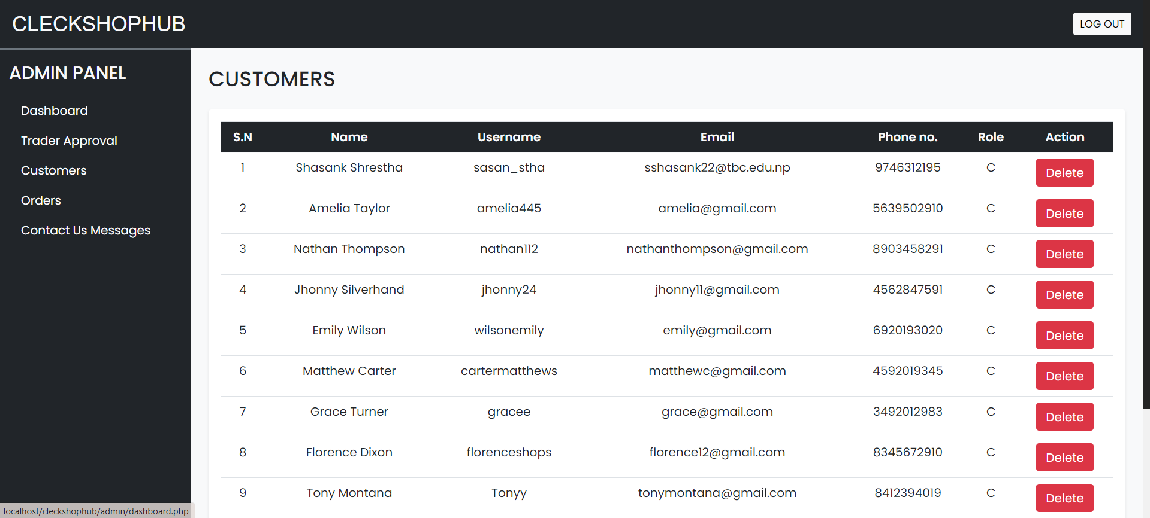
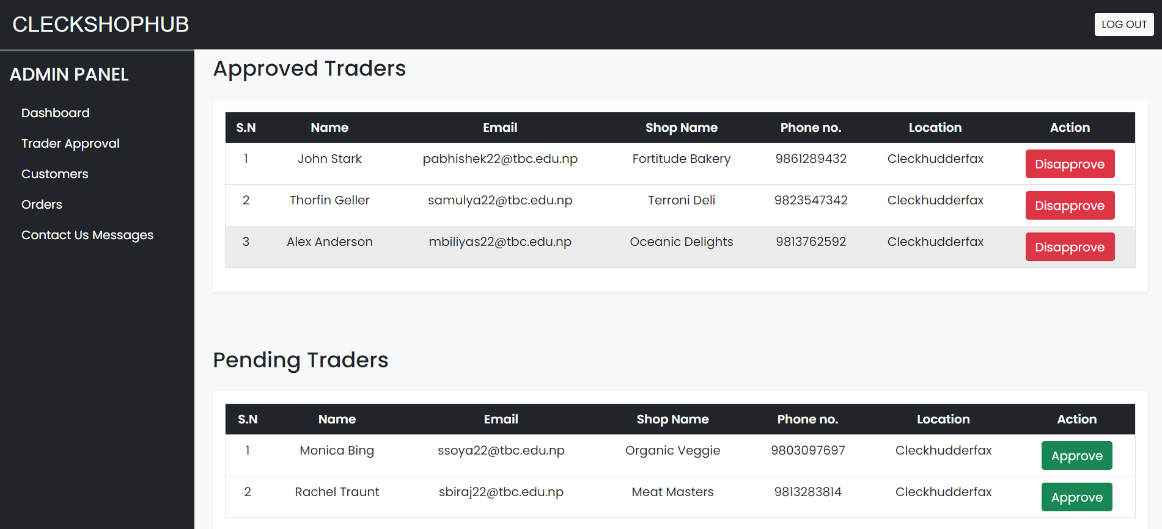
Admin Interface

Slide 23
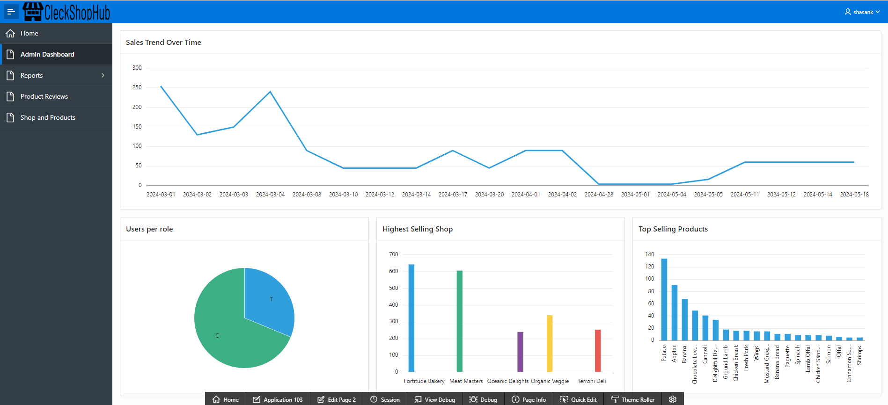
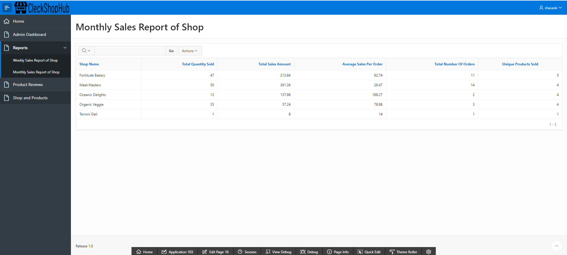
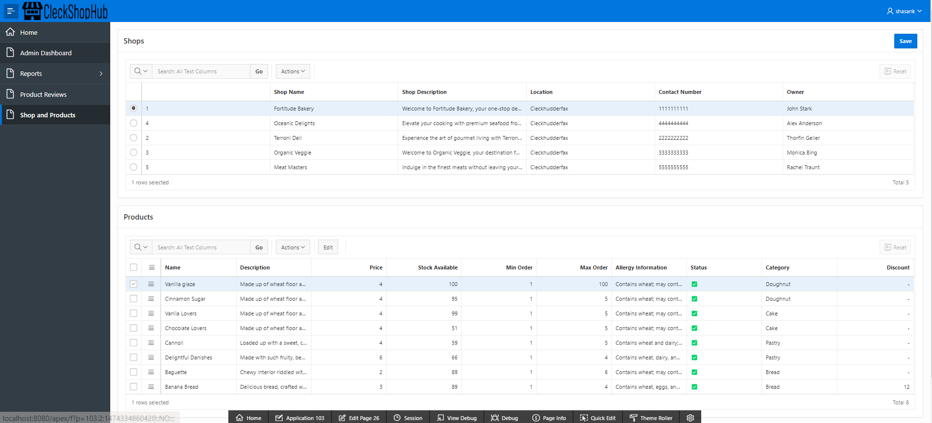
Admin Apex

Slide 24




Thank you !

